Slide 1
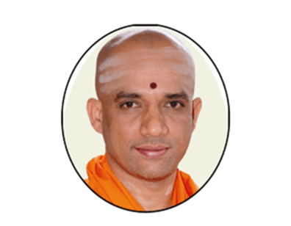
Adichunchanagiri Institute of Business Management
|| Jai Shri Gurudev ||
Team Name : Lal Bahadur Shastri
Presentation Domain: Search Engines
Topic Name : Success and Failure analysis –Search Engines

Slide 2
Anonymous
AIBM-CODERS

Slide 3
OUR GROUP
Kiel
Fira
Himas
Aurel
Salsabila
Tanzila

Slide 4
PETA KONSEP
DASAR TEORITIS HUKUM LENZ
GGL INDUKSI
INDUKATOR

Slide 5
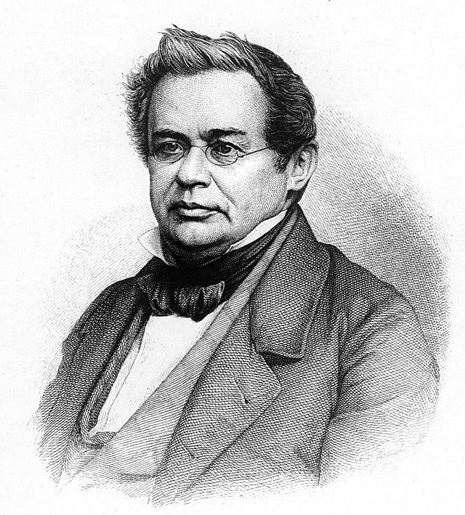
BUNYI HUKUM LENZ
“Arus listrik yang diinduksi akan selalu berusaha untuk menghasilkan fluks magnetik yang berlawanan dengan perubahan yang menyebabkannya”
Heinrich Lenz (1804-1865)

Slide 6
GGL INDUKSI
01
KONSEP

Slide 7
GGL INDUKSI
02
RUMUS
•
Perubahan luas per satuan waktu akibat pergeseran batang konduktor PQ memenuhi persamaan berikut:
• Ggl induksi memenuhi persamaan berikut:

Slide 8
INDUKSI DIRI
01
KONSEP

Slide 9
INDUKSI DIRI SEBUAH KUMPARAN
02
RUMUS
You can describe the topic of the section here

Slide 10
INDUKTANSI
01
02
The Title
You can describe the topic of the section here
You can describe the topic of the section here
03
The Title
You can describe the topic of the section here

Slide 11
The Title
You can describe the topic of the section here
ADD TITLE HERE
You can describe the topic of the section here
You can describe the topic of the section here
You can describe the topic of the section here

Slide 12
The Title
You can describe the topic of the section here
The Title
You can describe the topic of the section here

Slide 13
ADD TITLE HERE

Slide 14
You can describe the topic of the section here
You can describe the topic of the section here
You can describe the topic of the section here

Slide 15
ADD
TITLE HERE
You can describe the topic of the section here

Slide 16
THANK YOU

